Slide 1


GameON Tele
2026
ETHIO TELECOM
PARTNERSHIP PROPOSAL
GAMEON TELE: DIGITAL GAMING & ENTERTAINMENT PLATFORM
TELEBIRR · MOBILE GAMING · DIGITAL ENTERTAINMENT · COMPETITION · REWARDS
gameon-tele.com
Prepared by
Date
Icconect
September 2026

Slide 2


Current & Proposed Architecture
GameON Tele within
Telebirr SuperApp
GameON Tele integrates natively into the telebirr SuperApp as a white-label game portal. Users flow from TELEBIRR → GAME CENTER → GAMEON TELE → DISCOVER → SELECT → ACCESS → PLAY → SCORE → COMPETE → REWARD → RETURN. Proposed partnership enables carrier billing, subscription pricing, and national tournament cups to drive transactions and platform stickiness.
215.50M
30+
55M+
ETB 5-year projection
Games at launch
Telebirr user base
View Architecture

Slide 3

03 — Strategic Market Transition
From Traditional VAS
to Digital Gaming
Traditional Telecom VAS
Digital Gaming Ecosystem
Static, low-engagement content with minimal interactivity. High subscriber churn driven by lack of value. Declining ARPU as users migrate to OTT alternatives. Legacy pricing models with limited monetization flexibility.
Instant play with zero-install HTML5/WebGL technology. Social competition and leaderboards driving daily retention. Microtransactions and subscription tiers generating recurring revenue. High-frequency engagement across youth demographics.
High-growth opportunity
Digital gaming represents the fastest-growing segment in African telecom, replacing static VAS with engaging, monetizable experiences.
GameON Tele — Ethio Telecom Partnership
Page 03

Slide 4
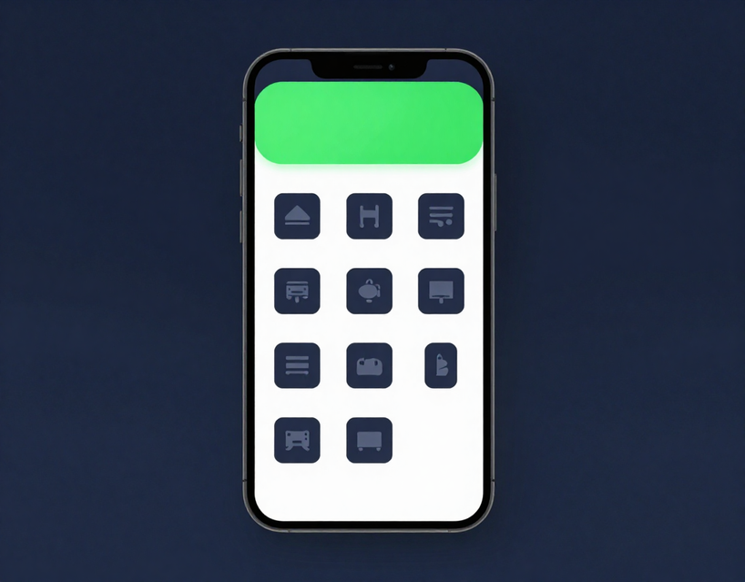
04 — Core Platform Pillars
GameON Tele
Ecosystem
Four integrated pillars power the GameON Tele platform — built for scale, optimised for telebirr, and designed to deliver measurable engagement across Ethiopia's digital gaming market.
DISCOVER
PLAY
Dynamic game categories, intelligent search, trending titles, and personalised activity logs surface the right content to every user instantly.
Zero-install HTML5/WebGL engine operates within the telebirr SuperApp webview. Sub-5MB bundles optimised for 3G/4G — mobile-first, frictionless, immediate.
COMPETE
MONETIZE
Game-specific leaderboards with masked MSISDN privacy, scheduled tournament brackets, Daily Sprint Cups, Weekly Championships, and Monthly Grand Invitationals.
Coin pay-per-play micro-transactions, Daily/Weekly/Monthly subscription tiers, and full telebirr API integration enabling seamless carrier billing and auto-debit.

Slide 5
05 — Strategic Value Proposition
Why Ethio Telecom Benefits from GameON Tele
Six high-impact strategic drivers that transform the telebirr SuperApp into a revenue-generating digital lifestyle platform for Ethiopia's youth.
1
2
3
SuperApp Engagement
Revenue & Retention
Scalable Ecosystem
Transform telebirr from a payments utility into a daily digital destination. Gaming drives repeat sessions, increases DAU, and deepens platform stickiness across 55M+ users.
Unlock high-margin digital revenue via subscriptions and coin micro-transactions. Gamification-led retention reduces churn and captures the high-value youth demographic at scale.
Frictionless carrier billing removes payment friction entirely. A modular roadmap scales from 30 to 100+ games, growing data bundle sales and cementing Ethio Telecom's digital ecosystem moat.

Slide 6
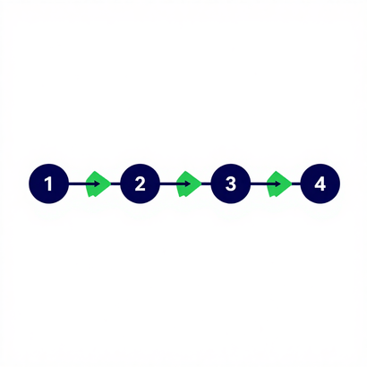
06 — Verified Workflow
Customer Journey:
GameON Tele Experience
1
2
3
4
Steps 1 – 3
Steps 4 – 6
Steps 7 – 8
Steps 9 – 10
Launch & Discover
Access & Play
Score & Compete
Reward & Return
  Open telebirr SuperApp and tap GameON Tele. 2. Browse the Discover screen — categories, trending, and personalized picks. 3. Select a game from the dynamic catalog.
  Validate entitlement — subscription check or coin balance confirmed. 5. Game loads instantly via zero-install HTML5/WebGL engine. 6. Play begins — no download, no friction, mobile-first experience.
  Score is recorded — performance logged against masked MSISDN leaderboard. 8. Compete in scheduled tournaments — Daily Sprint, Weekly Championship, or Grand Invitational.
  Reward distributed — winners receive prizes, coins, or telebirr credits. 10. Return loop activated — notifications, new challenges, and personalized offers drive re-engagement.

Slide 7
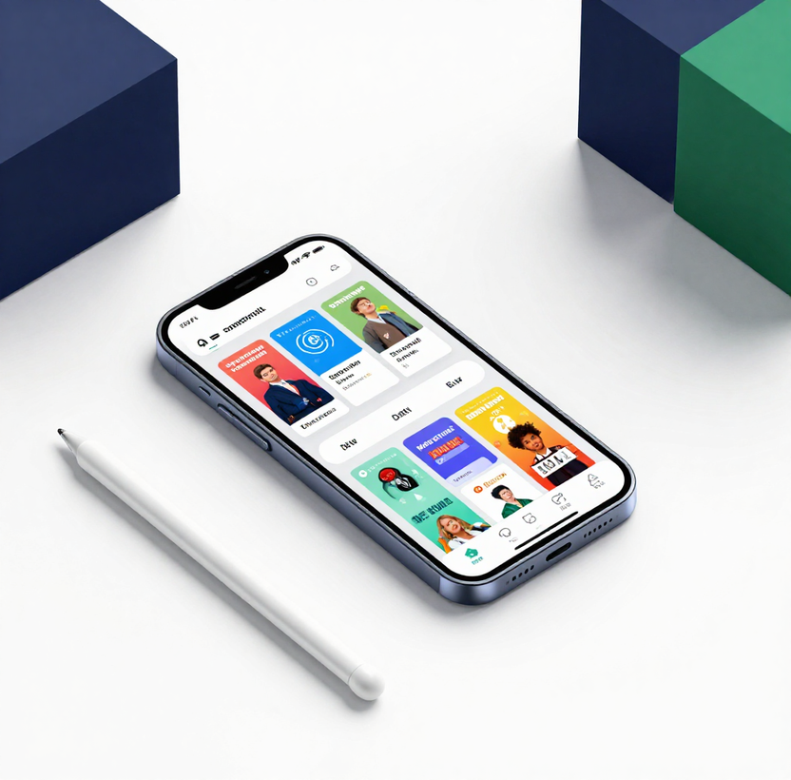
GameON Tele — Ethio Telecom Partnership Proposal
Source of
01
Solitaire Classic — Card / Puzzle | Coin Pay-Per-Play + Subscription
Truth
02
Ludo King — Board / Strategy | Coin Pay-Per-Play + Subscription
03
2048 Puzzle — Casual / Puzzle | Free Access + Coin Boost
04
Quiz Champion — Trivia / Education | Coin Pay-Per-Play + Subscription
05
Penalty Shootout — Sports / Arcade | Coin Pay-Per-Play + Subscription
06
Bubble Shooter — Casual / Arcade | Free Access + Coin Boost
07
Snake Reloaded — Casual / Arcade | Coin Pay-Per-Play + Subscription
+23
Catalog Titles — Mixed Genres | Various Access Models (Phase 1: 30 Games Total)

Slide 8
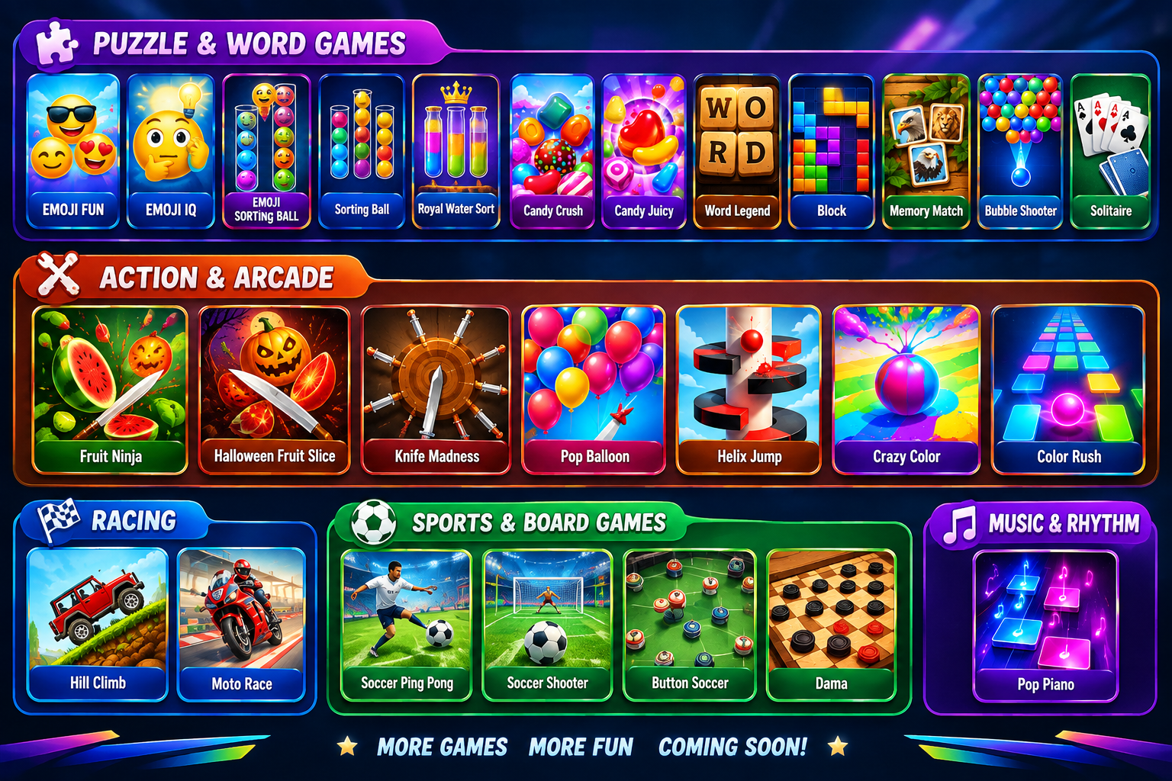



Slide 9
08 — Zero-Install Engine
Frictionless play,
GameON Tele operates entirely within the telebirr SuperApp webview. No App Store. No Play Store. No installs. Players access the full game catalog instantly from within the existing telebirr ecosystem.
no downloads required
01
02
03
Native SuperApp Webview
Lightweight Bundles
Entitlement Validation
All games run directly inside the telebirr SuperApp webview using HTML5 and WebGL. No external app installation is required at any point in the user journey.
Game bundles are sub-5MB and fully optimized for 3G and 4G networks. Low-bandwidth architecture ensures reliable performance across Ethiopia's diverse connectivity landscape.
Dynamic entitlement validation confirms access rights at session start. Future roadmap includes server-side anti-cheat validation to ensure tournament integrity and platform credibility.

Slide 10
09 — Business Architecture
Access & Monetization Models
Four revenue streams designed to serve every user segment — from casual browsers to committed competitors — within the telebirr SuperApp ecosystem.
1
2
3
Free Access
Coin Gaming
Subscriptions & One-Time
Target: All telebirr users. A curated selection of games available at no cost, driving discovery, platform adoption, and top-of-funnel engagement with zero friction.
Target: Casual & competitive users. Virtual coin pay-per-play model funded via telebirr micro-top-ups. Enables flexible, low-commitment monetization through the coin economy.
Target: Committed players. Daily (10 ETB), Weekly (50 ETB), and Monthly (100 ETB) passes via telebirr auto-debit. One-time purchases unlock premium titles or tournament entry for high-LTV users.

Slide 11
10 — Illustrative Proposed Pricing
Subscription Pricing Tiers
Prices are per telebirr user. All tiers subject to Ethio Telecom approval prior to commercial launch.
Daily Pass
Weekly Pass
Monthly Pass
10 ETB
50 ETB
100 ETB
24-hour access window
Unlimited play sessions
Leaderboard eligibility
Instant telebirr activation
7-day full access
~28% savings vs. daily
Auto-debit support
Full tournament eligibility
30-day full access
~67% savings vs. daily
Highest LTV driver
Auto-debit + priority support

Slide 12
11 — Coin Economy Architecture
Virtual currency lifecycle
Coins power micro-transactions across the GameON Tele platform. Users top up via telebirr, spend per game session, and earn bonus coins through competitive play and loyalty milestones.
& top-up bundles
01
02
03
Coin Lifecycle
Telebirr Top-Up Packs
Bonus Incentives
Select Game → Check Balance → Deduct or Top-Up → Play & Compete → Earn Bonus Coins → Return & Repeat. Each step is validated against the entitlement engine in real time via telebirr API.
Starter Pack: 50 coins — 5 ETB — No bonus
Basic Pack: 120 coins — 10 ETB — +10 bonus coins
Value Pack: 300 coins — 20 ETB — +40 bonus coins
Premium Pack: 700 coins — 40 ETB — +100 bonus coins
Mega Pack: 1,500 coins — 75 ETB — +300 bonus coins
Larger packs deliver progressively higher bonus coin yields, rewarding higher spend. Bonus coins are credited instantly and eligible for all games, tournaments, and leaderboard entries — reinforcing platform stickiness and repeat top-up behaviour.

Slide 13
12 — Tournament Brackets
Scheduled Esports Tournaments
Prize structure and reward types are subject to Ethio Telecom approval prior to launch.
Daily Sprint Cup
Weekly Championship
Monthly Grand Invitational
2 – 5 ETB
10 – 20 ETB
50 ETB+
Entry: 2–5 ETB coin deduction
Cycle: 24-hour reset
Rewards: Coin credits & badges
Eligibility: All active subscribers
Leaderboard: Daily ranking reset
Entry: 10–20 ETB coin deduction
Cycle: 7-day tournament window
Rewards: Coin bundles & trophies
Eligibility: Weekly pass holders
Leaderboard: Cumulative weekly score
Entry: 50 ETB+ coin deduction
Cycle: 30-day grand tournament
Rewards: Premium prizes & titles
Eligibility: Monthly subscribers
Sponsored Corporate Cups: Custom entry & reward tiers available for enterprise partners on request

Slide 14

13 — Target Scalability Roadmap
Phased Content Expansion
& Ecosystem Growth
1
2
3
4
Phase 1 — Current
Phase 2 — Pilot Expansion
Phase 3 — Studio Integration
Phase 4–5 — Full Ecosystem
30 Games
45+ Games
65+ Games
85–100+ Games
7 core titles + 23 catalog games. Foundation launch within telebirr SuperApp.
Localized content additions. Regional language support and culturally adapted titles.
Licensed third-party studio titles. Broader genre coverage and premium catalog depth.
Phase 4: Developer SDK enabling 85+ games. Phase 5: Full ecosystem with 100+ titles and open developer platform.

Slide 15
14 — Growth Flywheel
The self-reinforcing growth loop
Each stage of the GameON Tele ecosystem feeds the next — creating a compounding flywheel that drives engagement, monetization, and reinvestment across the platform.
1
2
3
Acquire & Engage
Compete & Retain
Monetize & Reinvest
More Games → More Choice → More Playtime. An expanding catalog drives discovery, increases session frequency, and deepens daily active engagement across all user segments.
More Competition → Higher Return Rate. Leaderboards, tournaments, and reward cycles create habitual return behaviour, reducing churn and strengthening platform loyalty.
Higher Monetization → Reinvestment → More Games. Revenue from subscriptions and coin micro-transactions funds catalog expansion, closing the loop and accelerating the next cycle.

Slide 16
15 — Operator Value Proposition
Why Ethio Telecom
GameON Tele delivers measurable commercial and strategic returns across every dimension of Ethio Telecom's digital growth agenda — from revenue to retention.
wins with GameON Tele
01
02
03
High-Margin Digital Revenue
SuperApp Stickiness & DAU Uplift
Youth Market & Ecosystem Moat
Subscriptions, coin micro-purchases, and carrier billing generate recurring, high-margin digital revenue streams with minimal infrastructure overhead.
Daily tournaments, leaderboards, and reward loops drive habitual return visits to telebirr, increasing daily active users and session depth across the SuperApp.
Gaming captures Ethiopia's youth demographic, builds long-term brand affinity, accelerates mobile data bundle sales, and creates a competitive moat against rival platforms.

Slide 17

16 — Partner Value Proposition
Partner Value
GameON Tele's strategic benefits from partnering with Ethio Telecom — from national distribution and frictionless payments to trusted co-branding and long-term ecosystem growth.
National Distribution
Frictionless Payments
Immediate access to 75M+ telebirr users across Ethiopia — no cold-start acquisition cost, no separate app store dependency.
Native telebirr micro-payment integration enables seamless coin top-ups, subscriptions, and one-time purchases with zero friction at checkout.
Trusted Co-Branding
Ecosystem Scaling
Ethio Telecom co-branding lends institutional credibility, driving user trust and accelerating adoption across all demographics.
Long-term partnership framework supports phased expansion to 100+ games, developer SDK access, and sustained platform innovation.

Slide 18
17 — Technical Capabilities
Platform Engineering &
GameON Tele is built on proven, production-grade technology designed for seamless integration within Ethio Telecom's SuperApp infrastructure and optimised for Ethiopia's network environment.
Technical Foundation
01
02
03
Game Engine Expertise
SuperApp Integration
Localisation & Design
HTML5 and WebGL engineering for zero-install, browser-native gameplay. Sub-5MB bundles optimised for 3G/4G with low-latency rendering across all Android and iOS devices.
Telecom Mini-App and SuperApp webview integration. Multi-tier entitlement and billing logic with dynamic validation, telebirr API connectivity, and carrier billing support.
Culturally localised game design tailored for Ethiopian users. Full multi-language support, Amharic-first UI, and content frameworks aligned with local preferences and demographics.

Slide 19

18 — Operating Model
Division of Roles &
Responsibilities
Ethio Telecom
GameON Tele
• Customer reach & national distribution
• SuperApp placement & promotion
• Carrier billing & telebirr integration
• Marketing & brand co-promotion
• Regulatory oversight & compliance
• Platform hosting & technical infrastructure
• Game catalog curation & expansion
• Tournament operations & scheduling
• Customer support & community management
• Continuous innovation & roadmap delivery
Structured for long-term partnership
Each partner contributes distinct core strengths, creating a complementary and scalable operating model built for sustainable growth.
GameON Tele — Confidential
Page 18

Slide 20
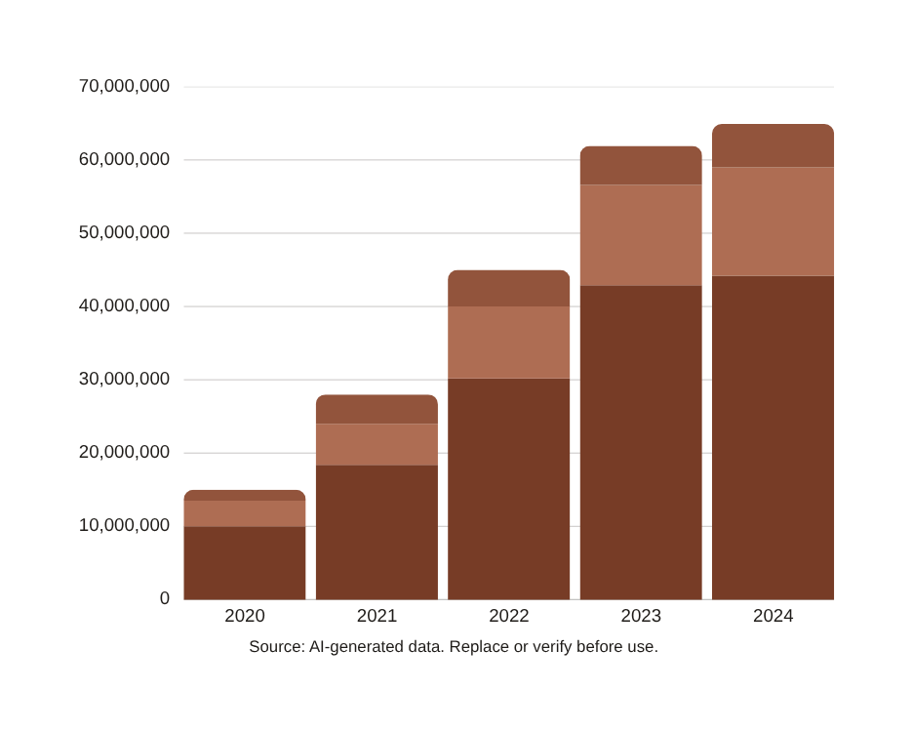
19 — Illustrative Revenue Model
Illustrative
ILLUSTRATIVE REVENUE MIX — SUBJECT TO ETHIO TELECOM APPROVAL
Revenue Model
65–70%
Recurring subscriptions (Daily, Weekly, Monthly Pass revenue)
20–25%
Coin micro-purchases via telebirr top-up bundles
5–15%
One-time purchases & other digital revenue streams. Subject to negotiation and agreement.

Slide 21
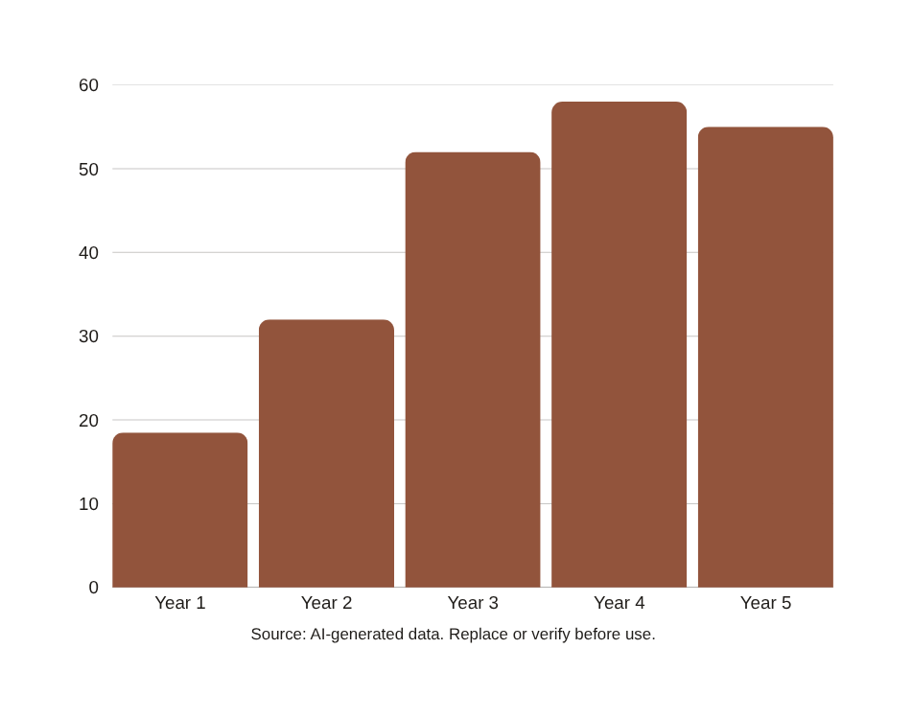
20 — Illustrative Base-Case Forecast
Five-Year Gross
GROSS ANNUAL REVENUE BY YEAR (ETB MILLION)
Revenue Projection
215.50M
ETB total 5-year gross revenue (base case)
55M+
Telebirr users addressable; Year 5 MAU target 3.50M paid
Yr1 → Yr5
Baseline launch to peak ecosystem; 15% paid conversion by Year 5

Slide 22
21 — Illustrative Commercial Scenario
Revenue Share Split
Baseline split: 55% Ethio Telecom / 45% GameON Tele. Subject to negotiation and final agreement.
Years 1 – 2
Years 3 – 4
Year 5 Peak
ETB 28.50M
ETB 89.20M
ETB 97.80M
Gross Revenue: 28.50M ETB
Ethio Telecom (55%): 15.68M ETB
GameON Tele (45%): 12.83M ETB
Reinvestment reserve: 10%
Regulatory & tax provisions apply
Gross Revenue: 89.20M ETB
Ethio Telecom (55%): 49.06M ETB
GameON Tele (45%): 40.14M ETB
Platform hosting fees deducted
Catalog expansion reinvestment
Gross Revenue: 97.80M ETB
Ethio Telecom (55%): 53.79M ETB
GameON Tele (45%): 44.01M ETB
5-Year Total: 215.50M ETB
All figures illustrative only

Slide 23
22 — Sensitivity Modeling
Sensitivity Modeling
5-year gross revenue outcomes under varying market adoption and conversion assumptions.
Conservative
Base Case
Upside
107.75M ETB
215.50M ETB
310.20M ETB
Lower MAU growth curve
Paid conversion: ~2–3%
Coin user rate: ~8%
Ethio Telecom share: ~59.26M ETB
Moderate MAU trajectory
Paid conversion: ~4–5%
Coin user rate: ~15%
Ethio Telecom share: ~118.53M ETB
Accelerated MAU adoption
Paid conversion: ~6–8%
Coin user rate: ~22%
Ethio Telecom share: ~170.61M ETB

Slide 24

GameON Tele × Ethio Telecom
Building
Ethiopia's Premier Digital Gaming & Lifestyle Ecosystem
Partnership Office
Date
GameON Tele Engineering & Commercial Partnership Office
September 2026
Reach
Notice
55M+ telebirr Users | National Distribution
Proposed strictly for strategic partnership discussion between GameON Tele and Ethio Telecom

